Slide 1
Promotion of economic development
By- Akshat Srivastav 19bce0811

Slide 2
Defining economic development
Economic development is the process by which the economic well-being and quality of life of a nation, region or local community are improved.
Economic growth is a phenomenon of market productivity and rise in GDP and is one aspect of the process of economic development.

Slide 3
Goals of economic development
To reduce unemployment, achieve economic stability, and increase the standard of living for all citizens.
To build a highly skilled, flexible workforce.
To concentrate on retaining and expanding existing local businesses.
To maintain and strengthen region’s position as a tourist destination.
To promote and encourage preservation of the region’s historic assets.
To strengthen the local tax base.
To encourage development that is environmentally sensitive.

Slide 4
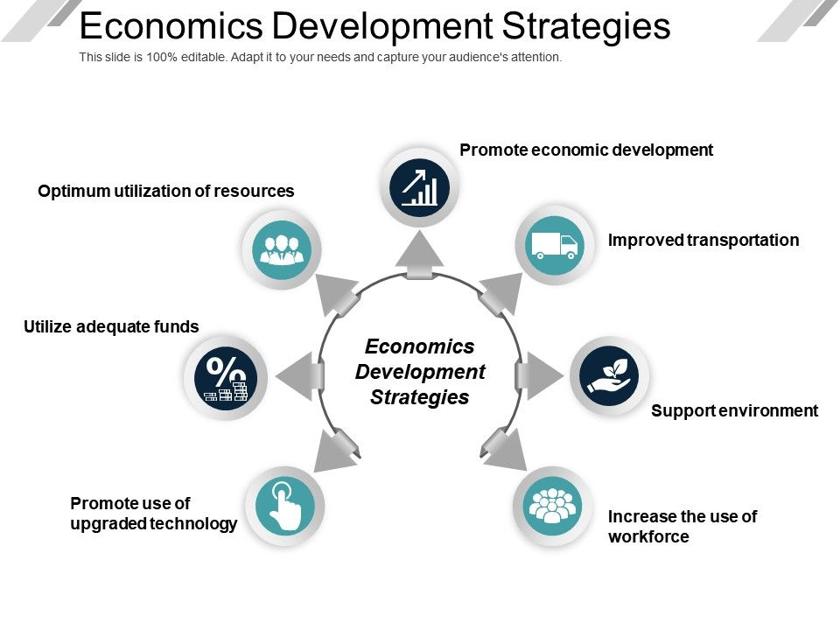

Slide 5
Policies of Economic development
In its broadest sense, policies of economic development encompass two major areas:
Governments undertaking to meet broad economic objectives such as price stability, high employment, and sustainable growth. Such efforts include monetary and fiscal policies, regulation of financial institutions, trade, and tax policies.
Programs that provide infrastructure and services such as highways, parks, affordable housing, crime prevention, and K–12 education.
Job creation and retention through specific efforts in business finance, marketing, neighbourhood development, workforce development, small business development, business retention and expansion, technology transfer, and real estate development.
This third category is a primary focus of economic development professionals.

Slide 6
Development indicators and indices
1. GDP per capita
GDP per capita is gross domestic product divided by mid year population. GDP is the sum of gross value added by all resident producers in the economy plus any product taxes and minus any subsidizes not included in the value of the products. It is calculated without making deductions for depreciation of fabricated assets or for depletion and degradation of natural resources.
2. Social security and pensions
3. Modern transportation
European development economists have argued that the existence of modern transportation networks- such as high-speed rail infrastructure constitutes a significant indicator of a country's economic advancement: this perspective is illustrated notably through the Basic Rail Transportation Infrastructure Index (known as BRTI Index) and related models such as the (Modified) Rail Transportation Infrastructure Index (RTI).

Slide 7
Community competition
One unintended consequence of economic development is the intense competition between communities, states, and nations for new economic development projects in today's globalized world.
With the struggle to attract and retain business, competition is further intensified by the use of many variations of economic incentives to the potential business such as: tax incentives, investment capital, donated land, utility rate discounts, and many others. IEDC places significant attention on the various activities undertaken by economic development organizations to help them compete and sustain vibrant communities.

Slide 8
THANK YOU1
REFERENCE MATERIAL CITED:
Wikipedia
https://www.dubuquesmartplan.org/pdf/EconomicDevelopmentGoalsandObjectivesDraftApporved1-11-2011.pdf
https://www.google.com/url?sa=i&source=images&cd=&ved=2ahUKEwiWq5fojq7lAhXCfH0KHTO5ArMQjRx6BAgBEAQ&url=https%3A%2F%2Fwww.slideteam.net%2Feconomics-development-strategies-ppt-presentation.html&psig=AOvVaw11ANeIgNr5qRidtZKssAmv&ust=1571773510015534

